Slide 1

AI-Enhanced Library Borrowing System
Term Project
Advanced Information Retrieval
Professor: 이우기 교수님
Nirmal Adhikari (22241817)
Smart Engineering/BMSE
2025-06-09
Notes:
“Hello everyone, my name is Nirmal Adhikari from the Smart Engineering and BMSE department. This is my term project for the Advanced Information Retrieval course, and today I’ll be presenting an AI-enhanced library borrowing system designed for a modern campus environment.”
“This system addresses key issues in traditional libraries and brings them closer to smart campus standards using automation, AI, and better data handling.”

Slide 2
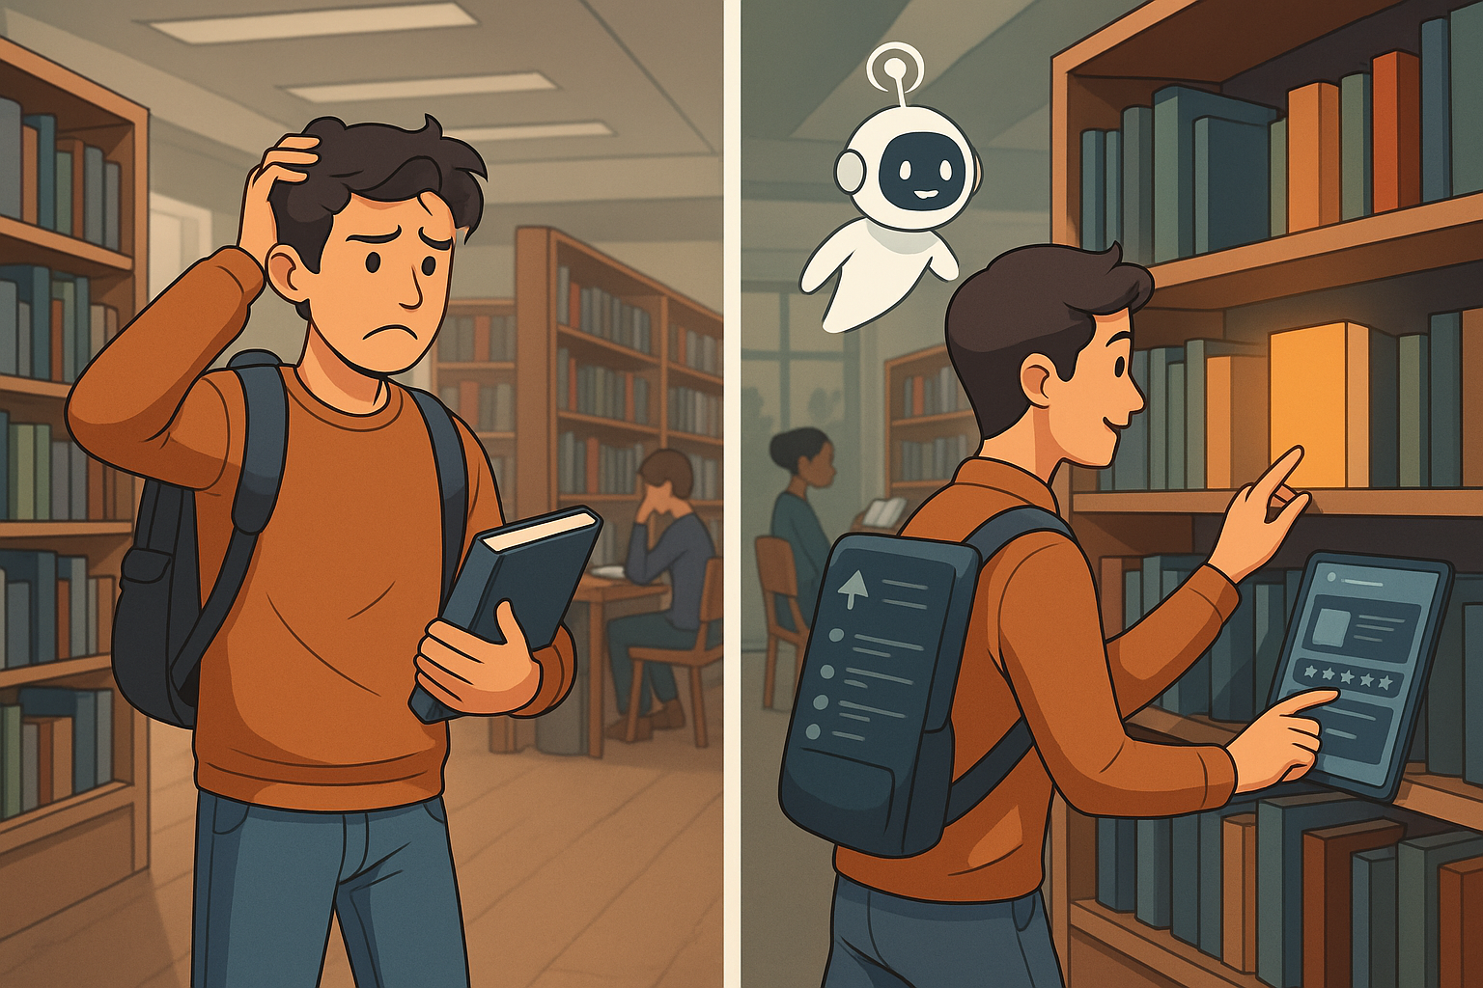
Project Overview
What is this project about?
AI-powered upgrade for campus library borrowing
Features include:
Smart assistant for finding books
Real-time shelf availability tracking
Fast and automated checkout
Why build this?
Students face delays and confusion in current library systems
Most libraries still operate manually
What’s the goal?
Make borrowing books as smooth as using a smart app
Reduce wait times, help users, modernize campus experience
Notes:
“This project is about upgrading the typical library system into something smarter, faster, and easier to use.”
“We focused on three key features:->A smart assistant to help users find books ->Real-time shelf tracking ->And an automated checkout system”
“The reason we need this is because most campus libraries still rely on manual searching and borrowing. Students waste time, face confusion, and often don’t know if a book is available.”
“The goal is to make the experience feel like using a smart app — something intuitive and instant.”

Slide 3
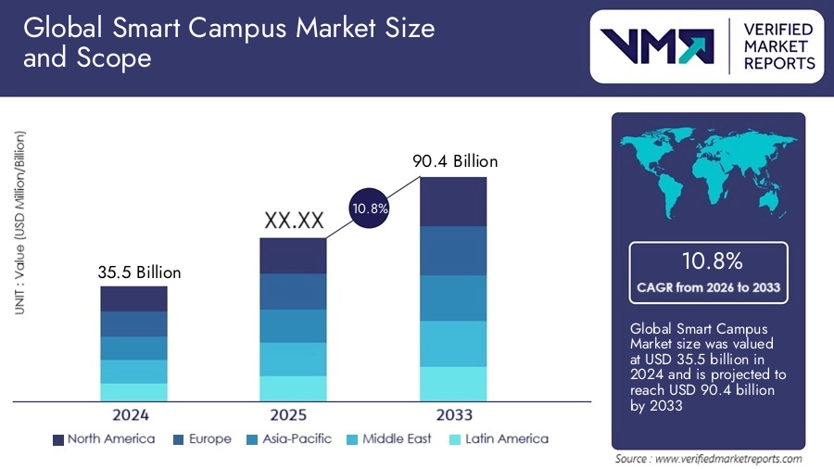
Market Demand
What’s the problem?
Long search times, unavailable books
Manual checkout still common
What’s the solution?
AI assistant to help users
Real-time book tracking
Smarter, faster borrowing
Why does it matter?
Smart campus tech is booming
Libraries are next in line for upgrades
Notes:
“So why is this the right time for this system?”
“The current problems are clear: Students face long search times, books are often unavailable, and checkout is still manual.”
“Our solution is to bring in AI: An assistant that helps users, tracks books in real-time, and speeds up the whole borrowing process.” “And more importantly, smart campus technologies are booming. As shown in market reports, investment in smart systems is growing fast — and libraries are next in line.”

Slide 4
Process Design
App Interaction
Physical Movement
Checkout & Completion
10s
10s
Start
User Enters Library
Launch App
Logged in?
Yes
Ask AI to Find Book
Book
Available?
No
No
10s
30s
Yes
Recommend alternatives/Waitlist
Login/
Register
5s
Show shelf location
10s
30-90s
Pick Book
Move to Shelf
30-90s
5s
Self-checkout at kiosk/app
System updates borrow status
End
Notes:
“This slide shows the full journey of a student using our AI-enhanced library system, starting from the moment they enter the library.”
“First, the user launches the library app. If they’re not logged in, they go through a quick login or registration process.”
“Then, they ask the AI assistant to help find a book. If the book is available, the system shows the exact shelf location. If not, it recommends similar books or gives the option to join a waitlist.”
“Next, the user walks to the shelf, picks the book, and goes to the self-checkout station or uses the app.”
“Once the checkout is complete, the system automatically updates the borrow status in the database.”
“We’ve also added estimated times for each step to show that the process is fast and efficient — usually under 2 minutes in total.”

Slide 5
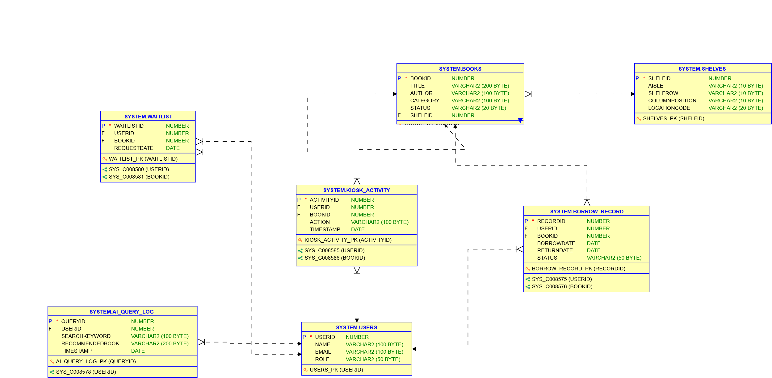
Database Design
What
Where
What
What
How
What
Why
Who
Notes:
“This slide explains how our database design answers the key 5W1H questions — who, what, when, where, why, and how.”
“At the center of everything is HOW — our system works through user actions logged in the KIOSK_ACTIVITY table. Each interaction — like checkout or return — is tied to a real user and a real book. This makes it the core of our operational flow.”
“WHO uses the system is captured in the USERS table — whether it’s students or admins.”
“WHAT objects the system manages — the books — are handled by the BOOKS table and tracked through BORROW_RECORD and WAITLIST.”
“WHEN each action happens is recorded through timestamp fields in every activity table — whether it's borrowing, querying the AI assistant, or using the kiosk.”
“WHERE books are located is managed in the SHELVES table — which gives physical shelf data like aisle, row, and column.”
“WHY certain interactions happen — such as search or waitlisting — is explained by data in AI_QUERY_LOG and WAITLIST, showing user intent and fallback handling.”
“This 5W1H structure proves that our system is not just a set of tables, but a fully thought-out design that maps real-world library logic into relational data.”

Slide 6
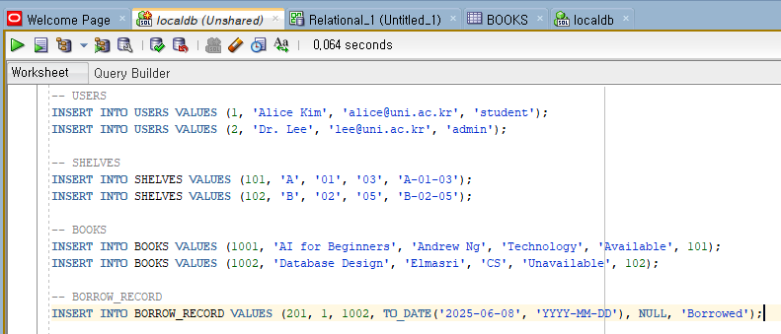
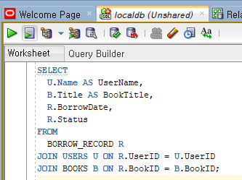

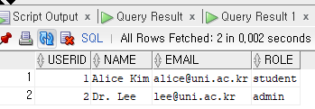
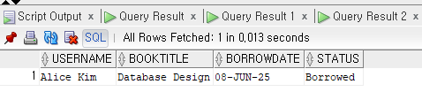


Data Insertion and Querying
Polluting Database
Borrowing Operation Demonstration
Notes:
“This slide shows how we inserted real data into the system to simulate actual usage.”
“On the left, we created users, shelves, books, and borrowing records. You can see Alice Kim borrowing the book Database Design, and everything is recorded in our BORROW_RECORD table.”
“Below that, we verified the data by selecting from each table and checking that all rows were inserted properly.”
“On the right side, we ran a join query that combines USERS, BOOKS, and BORROW_RECORD tables to show exactly who borrowed what and when.”
“The result shows Alice Kim borrowed Database Design on June 8 — this confirms our relationships and foreign keys are working correctly.”

Slide 7
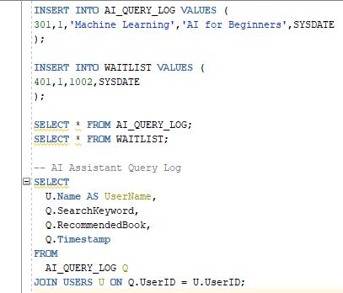

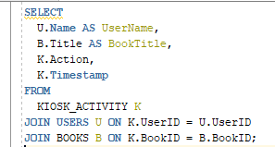




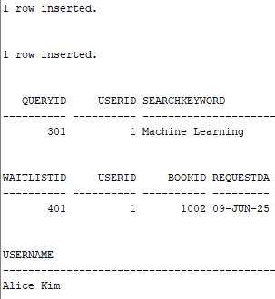



Data Insertion and Querying
AI Assistant Query Log
Kiosk Action Demonstration
Notes:
“This slide continues with our system validation through AI logs and kiosk activity.”
“On the left, we logged a smart assistant interaction — Alice searched for Machine Learning, and the system recommended AI for Beginners.”
“We also inserted a waitlist record, showing that Alice joined the queue for an unavailable book.”
“On the right side, we show the upgraded KIOSK_ACTIVITY table in action. This logs how Alice used the kiosk to check out Database Design — including the exact time it happened.”
“This final join query confirms that we’ve connected the kiosk to both the user and the book — which completes our 'HOW' component in the system.”

Slide 8
Conclusion
What We Did
Designed an AI-enhanced library borrowing system
Modeled the entire process: from search to borrowing
Built a normalized relational database with 7 linked tables
What We Proved
Inserted real data into all key tables
Ran multi-table join queries to verify relationships
Logged smart assistant queries and waitlist actions
Why It Matters
The system modernizes campus libraries
Reduces time, confusion, and manual operations
Easily scalable and ready for intelligent extensions
Notes:
“To conclude, we’ve not only built a technically sound database — we’ve demonstrated how it reflects real-world use cases, supports intelligent interaction, and contributes to a more efficient and modern library system. This project showcases both practical SQL skills and the design thinking behind user-centered database systems.”

Slide 9
Thank You

